Slide 1
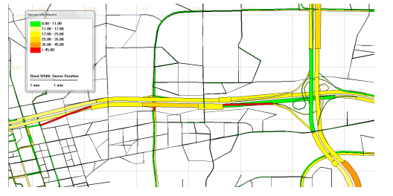
Open-sourece DTALite/NeXTA library based on GMNS
Dr. Xuesong (Simon) Zhou
xzhou74@asu.edu
Arizona State University
02/17, 2020

Slide 2
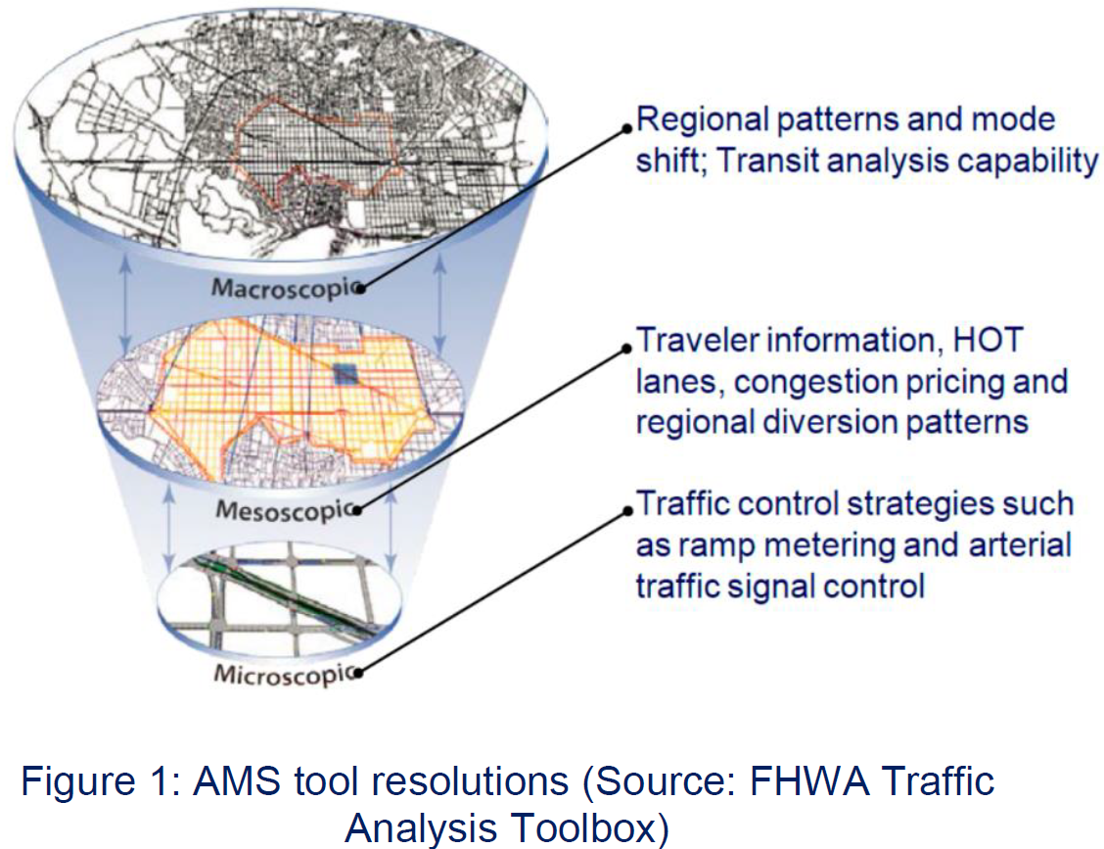
1.Quick introduction of DTAlite
Macroscopic assignment: --DTAlite (Static/Semi-dynamic assignment)
Mesoscopic assignment: --DTAlite (Dynamic assignment)

Slide 3
Quick introduction of DTAlite
Macroscopic assignment: --DTAlite (Semi-dynamic assignment)
Mesoscopic assignment: --DTAlite (Dynamic assignment)
Microscopic assignment: --CAlite (Cellular Automatonassignment )

Slide 4
Quick introduction of light-weight simulation tools
Welcome to STAlite (Light-weight computational engine of Static Traffic Assignment and Semi-dynamic assignment)
STAlite is an open-source AMS library for efficiently macroscopic traffic assignment
based on General Modeling Network Specification (GMNS) format
Network representation based on GMNS format
Extendable Volume Delay Function (VDF) functions：
Standard BPR function
BPR_X function that can obtain dynamic travel time efficiently
Path flow based internal representation to reach users equilibrium (UE)
Space time network based discrete event vehiclular simulation per 1 second
Enable dynamic OD demand estimation (ODME) using different data sources
Efficient multi-threading parallel computation and memory management, implemented in C++
Utilize up to 40 CPU cores, 200 GB of Memory for networks with more than 500K nodes

Slide 5
2. Network representation based on the General Modeling Network Specification (GMNS)

Slide 6
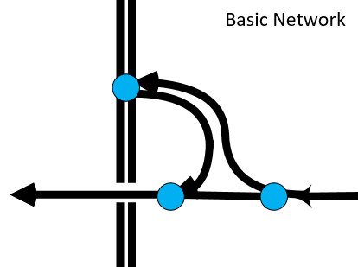
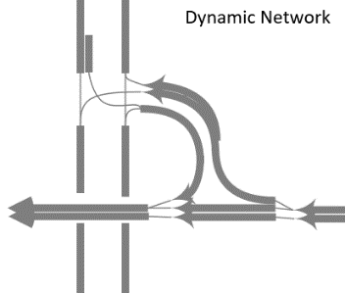
Network representation based on GMNS github.com/zephyr-data-specs/GMNS
The objective of the General Modeling Network Specification (GMNS) is to provide a common human and machine-readable format for sharing routable road network files
It is designed to be used in multi-resolution and multi-modal static and dynamic transportation planning and operations models
It will facilitate the sharing of tools and data sources by modelers
The project is overseen by a project management group, with MPO, city, industry, academic and US DOT participation. In 2019, with support from the Federal Highway Administration, the team developed requirements and an initial release of the specification

Slide 7
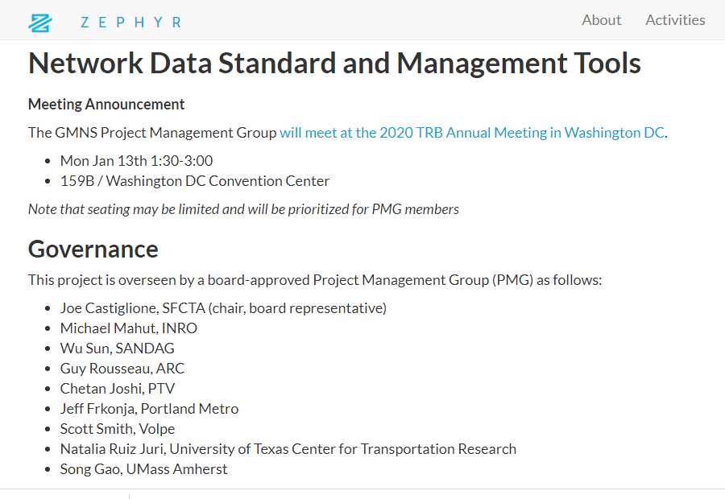
Network representation based on GMNS github.com/zephyr-data-specs/GMNS

Slide 8
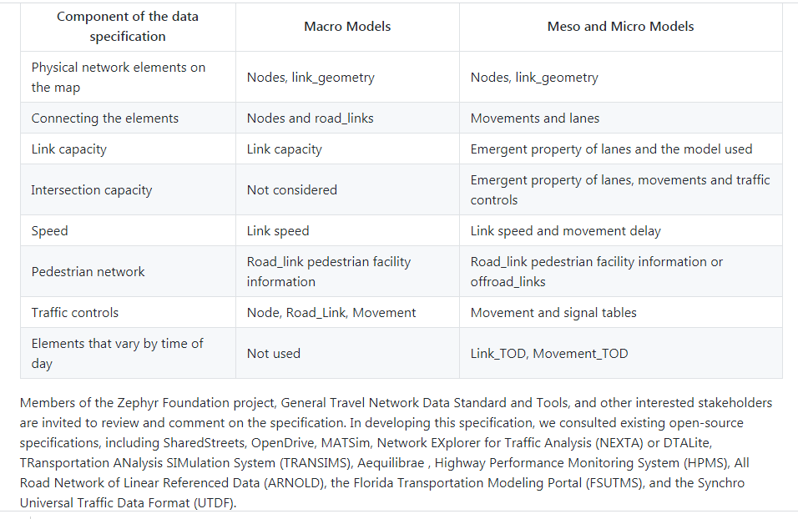
Network representation based on GMNS github.com/zephyr-data-specs/GMNS

Slide 9

3. Open-source Nexta AMS data hub for GMNS format

Slide 10
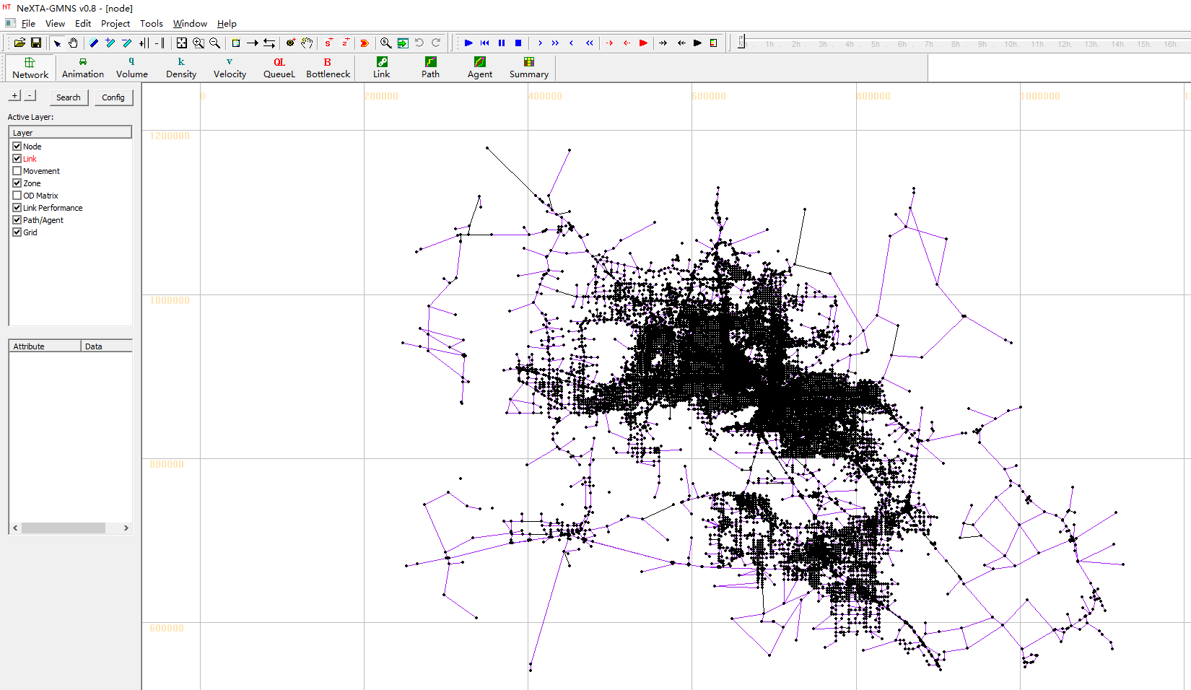
Open-source Nexta AMS data hub for GMNS format

Slide 11
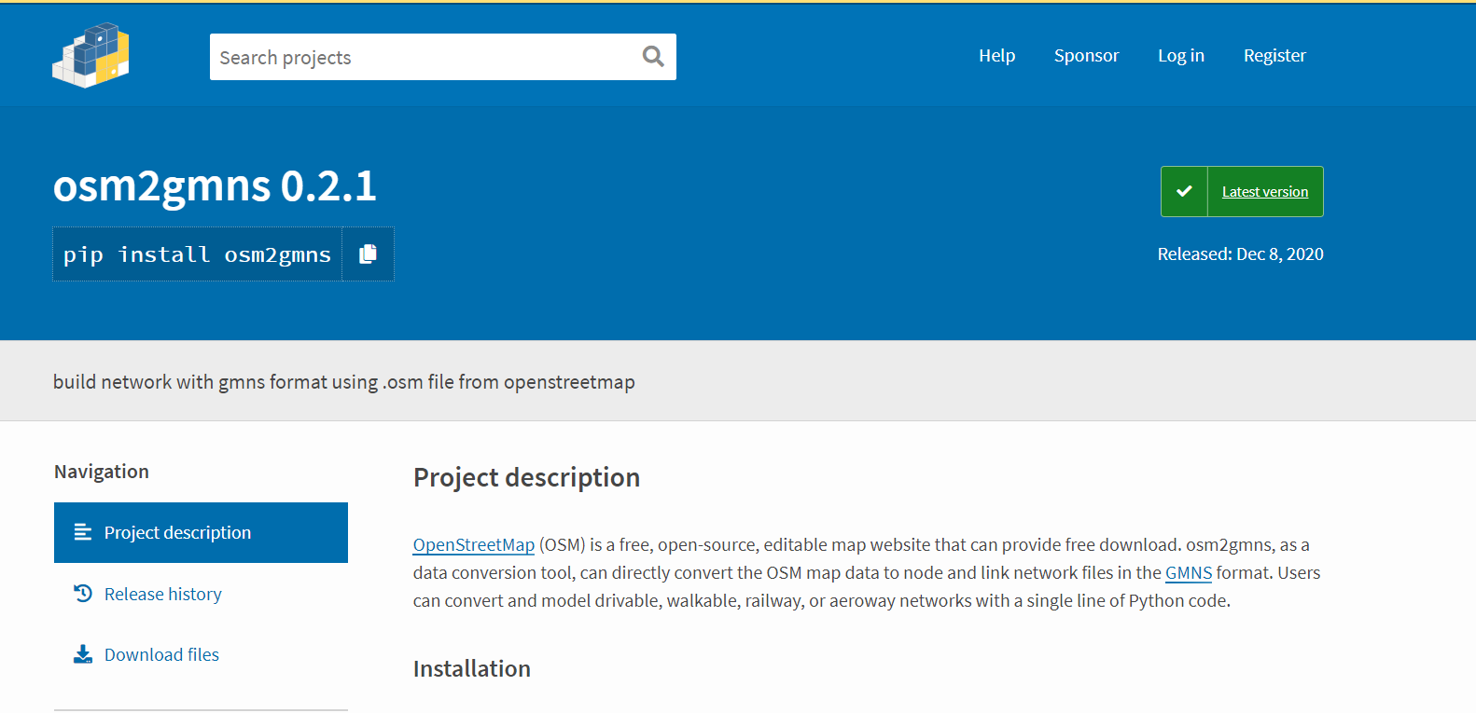
Method 1 for creating network: Open-Source Network Downloader
https://pypi.org/project/osm2gmns/

Slide 12
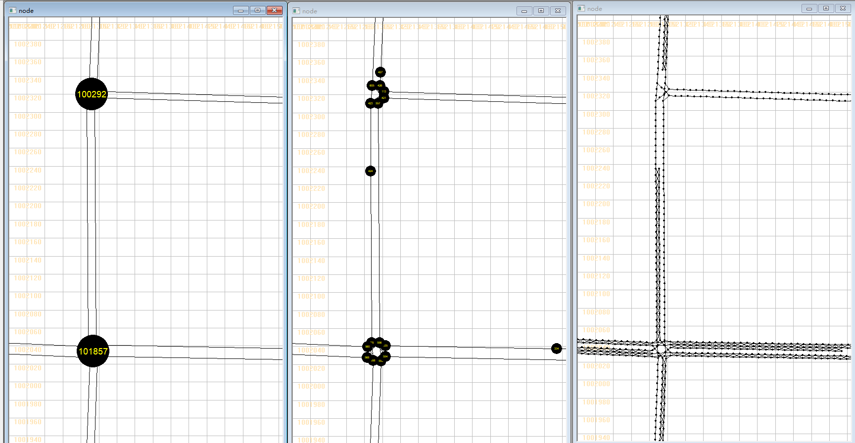
Method 2 for creating network: Multi-Level Network Convertor (Net2Cell)
https://pypi.org/project/net2cell/
Open-source tool for creating cell-based (microscopic) and mesoscopic and macro Networks
Produced by ASU NSF project: Real-time Management of Large Fleets of Self-Driving Vehicles Using Virtual Cyber Tracks
Macroscopic Network
Mesoscopic Network
Microscopic Network

Slide 13
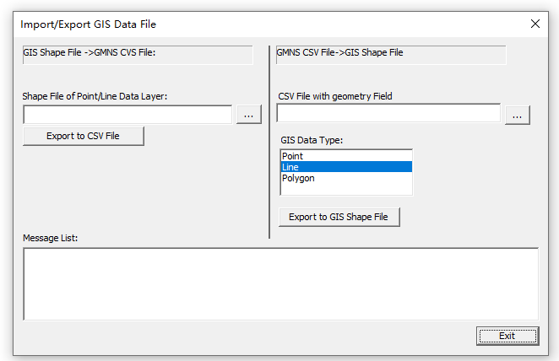
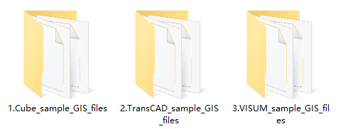
Method 3 for creating network: Convert GIS Shape File to GMNS CVS files
Shape files -> GMNS CVS files
Cube GIS files
TransCAD GIS files
VISUM GIS files

Slide 14
Database development for using sensor data
Database development: Prepare the network configuration and link performance files in the database.
Filegroup | Output file list | Remarks
Network | 1. node.csv 2. link.csv | Network representation based GMNS format
Observations | 3. link_performance.csv | (One-way) link-based speed and count data based on link format, for different resolutions
Data preparation mainly including network configuration and link performance file preparation.

Slide 15
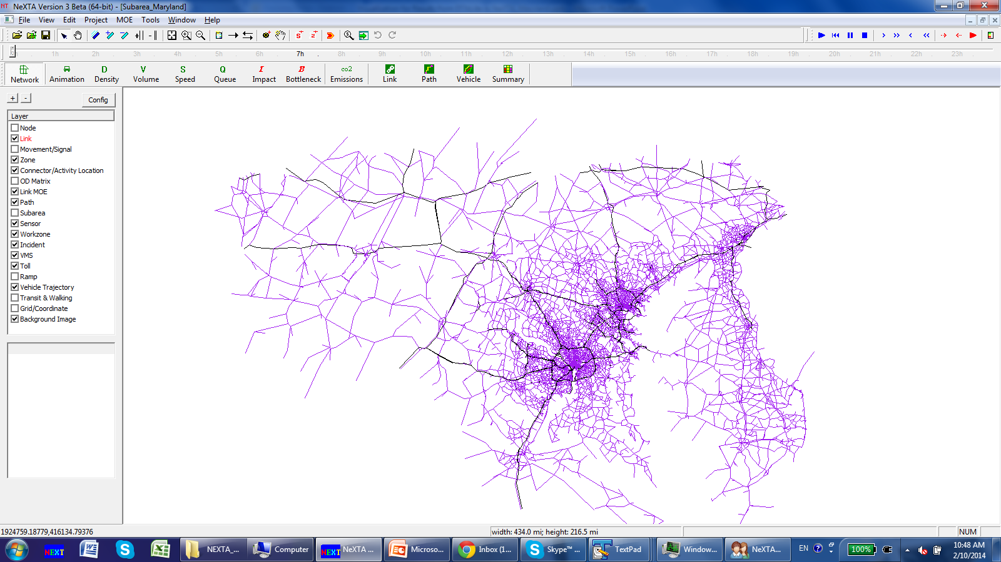
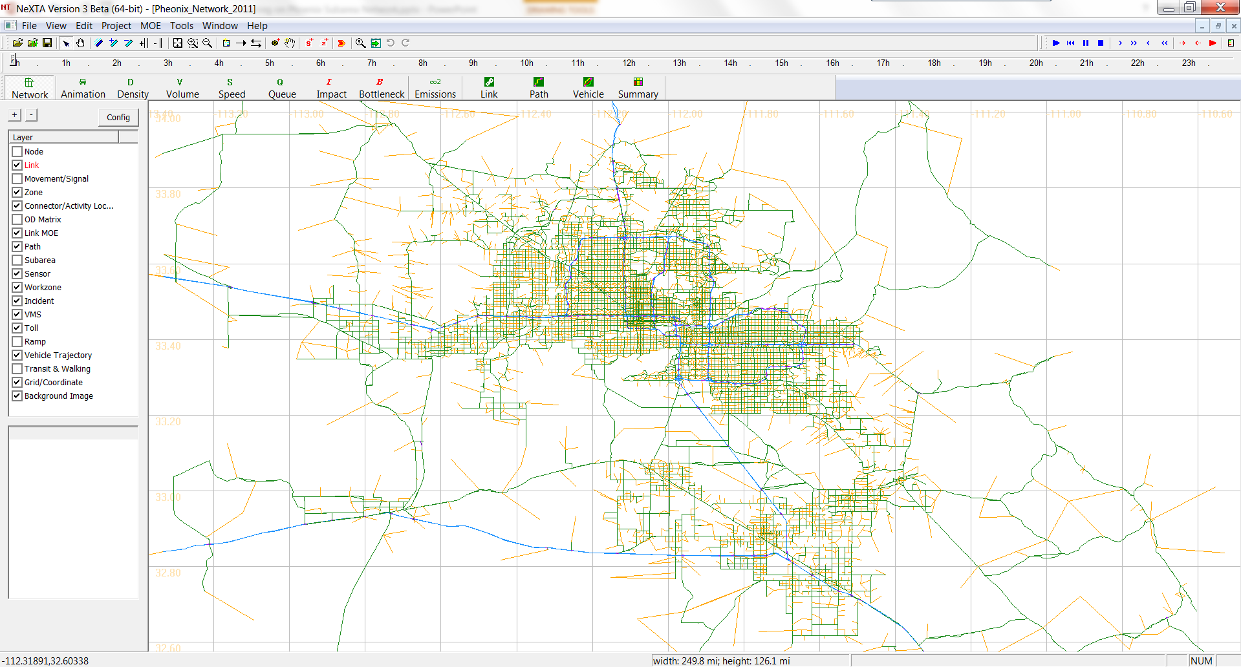
High-Resolution Map
Maryland Network | Data
# of nodes | 21,748
# of links | 62,232
# of zones | 1,598
# of agents for 24 hours | 18 million
Phoenix Network | Data
# of nodes | 19,523
# of links | 47,712
# of zones | 3,022
# of agents for 24 hours | 10 million

Slide 16
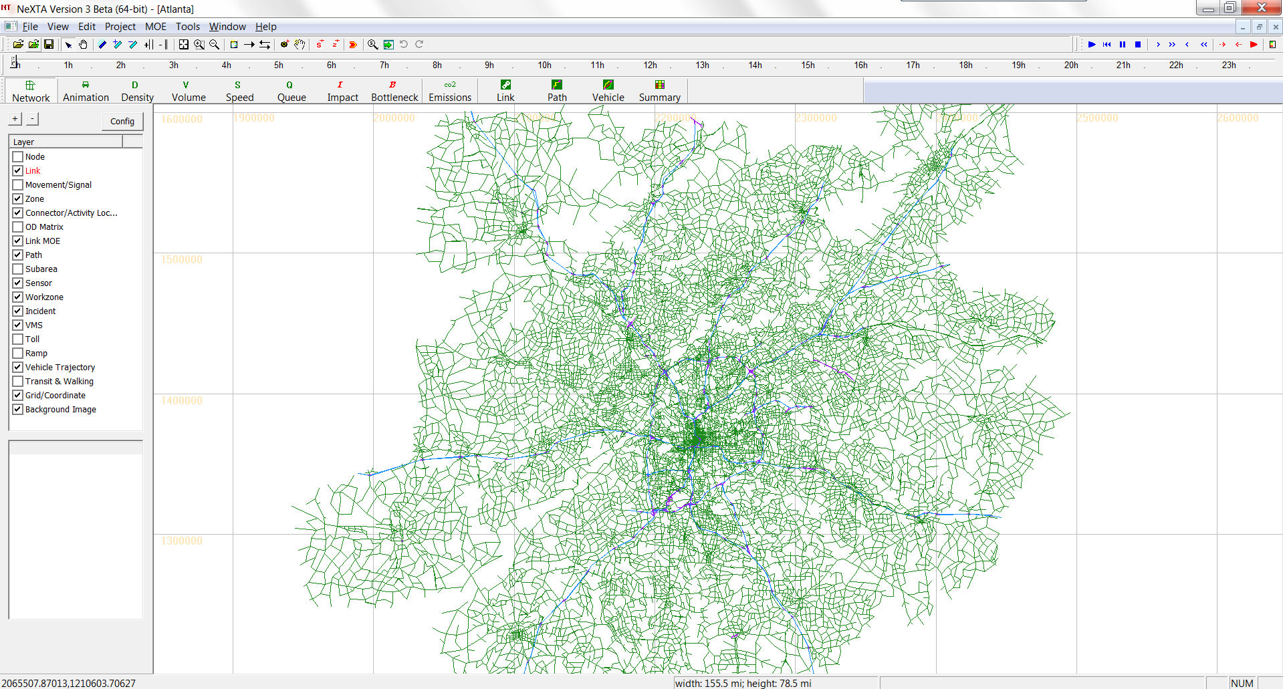
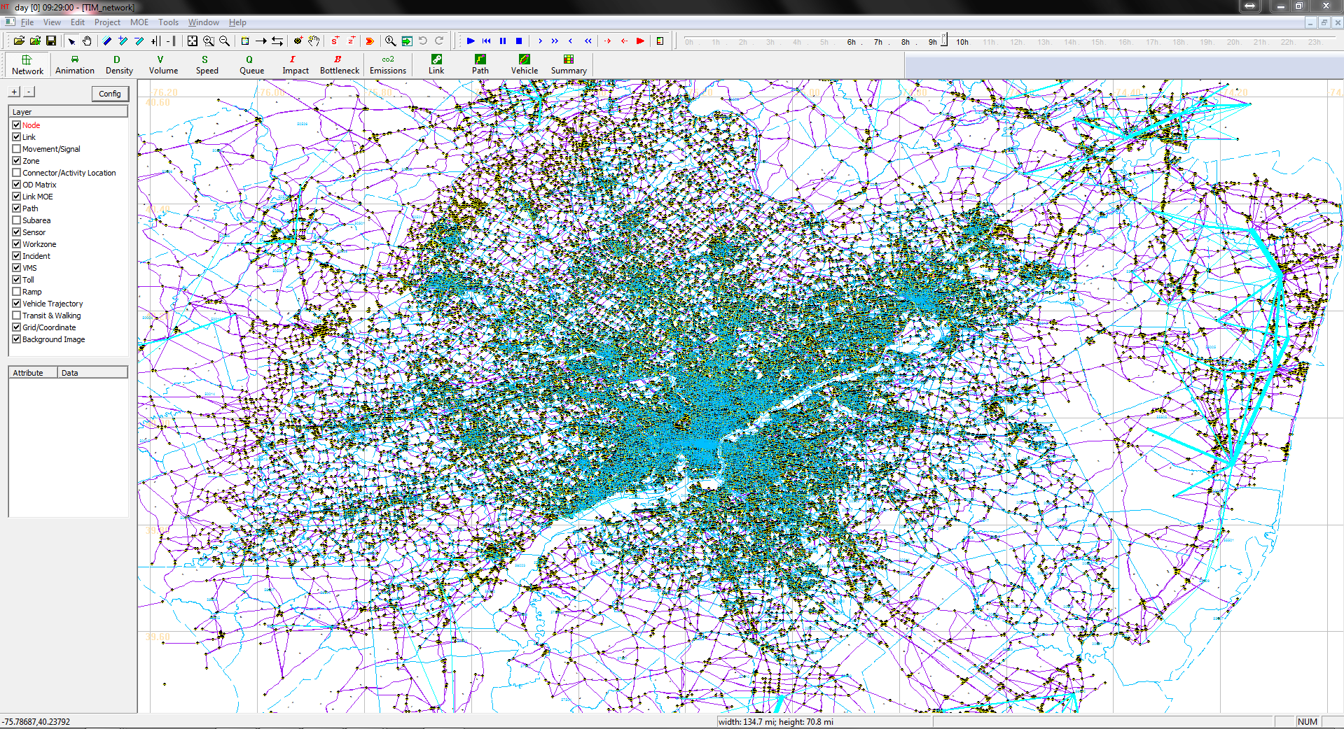
High-Resolution Map
Atlanta Network | Data
# of nodes | 26,988
# of links | 71,493
# of zones | 5,981
# of agents for 24 hours | 11.6 million
Philadelphia Network | Data
# of nodes | 86,853
# of links | 256,350
# of zones | 3,399
# of agents for 24 hours | 5.1 million

Slide 17
Issues in Using Open Street Map in DTA model
The US Geological Survey has aerial imagery for the entire state of Maryland at a 6" resolution.
Fall 2007 to spring 2008: highest-resolution and newest imagery available for use in OpenStreetMap
Issues
Traffic Analysis Zone Mapping
Capacity values and number of lanes
Signal data layers
Connection with sensor data

Slide 18
THANKS

